Slide 1
Hinton-Alderson Airport WV77 37° 40.801'N/ 80° 42.624'W
Park in this area.
This area can be wet/soft.
Wires along this road.
Trees.
Runway 28/10. 2700’ X 40 Sod.

Slide 2
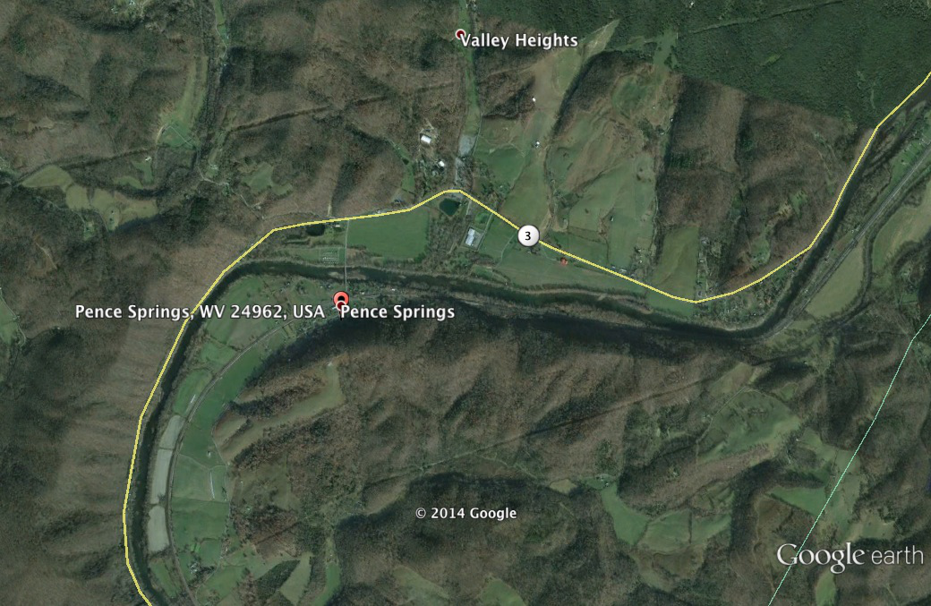
Power Lines
Runway 28/10. 2700’ X 40’ Sod.
Cell Tower

